Slide 1


2018

Slide 2
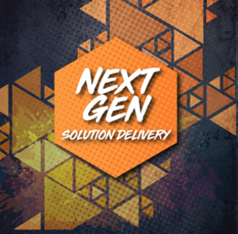
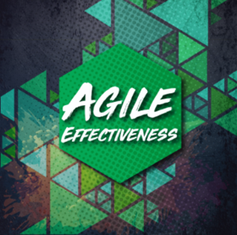

2018
OpenShift (OCP) Workshop
Jeff Li

Slide 3
Agenda – 5 min
The Team
Sandra, Walid, John, Harold, Sahil, Dhwanil, Thomas, Ronald, Christine, Justin, Darren
OpenShift at RBC - Sandra, Walid, John, Harold
OCP cluster we had so far
Operating and Supporting team
Workshop - Jeff
Deploy a Docker Image on OCP
Build and Deploy an App with OCP s2i
RBC OpenShift Architecture and Roadmap - Jeff
Typical OCP Architecture
Other components in OCP Eco-System
RBC Apps on OCP - Sahil, Thomas, Dhwanil
RBC Express
Chorus
Jenkins master/slave
Q & A

Slide 4
The Team
Sandra, Christine - DevOps
Walid - Cloud Operations
John, Harold - Linux Operations
Dhwanil, Thomas, Ronald, Jeff, Justin, Darren - Hosting Engineering
Sahil - DevOps

Slide 5
OCP at RBC: 5 min
DEV Env
Chorus LIVE
Project Lock
Jenkins Master/Slave
DevOps PI3
Investigation
to Enterprise Kubernetes
OpenShift Explored
POC DEV/SAI
DevOps PI1
Q1 2017
Q2 2017
Q3 2017
Q4 2017
Q1 2018
ENG Lab POC
SAI Env
PROD – SCC/GCC
DevOps PI2
In 2017, the DevOps Program adopted the Scaled Agile Framework (SAFe) and began a journey of a new way of working.
This framework is organized into Program Increments (PI) during which an Agile Release Train (ART) delivers incremental value in the form of working, tested software and systems. A PI is time-boxed at 12 weeks consisting of five 2-week development sprints and one Innovation & Planning (IP) sprint.

Slide 6
Workshop – Lab: 45 min
User Experience on OCP
Developer Guide
https://access.redhat.com/documentation/en-us/openshift_container_platform/3.6/html/developer_guide/
This Slides
http://rcb201.rc.helab.devfg.rbc.com/AgileSymposium2018-OpenShiftWorkshop-v6.pptx
Deploying a Docker Image on OCP
Ocp gui: https://console.c1-ocp-dc1.devfg.rbc.com
docker-redhat.rbcartifactory.fg.rbc.com/rhscl/httpd-24-rhel7:2.4-48

Slide 7
Workshop – Lab: 45 min - Continued
Build and Deploy Apps with OCP s2i
Putty: ssh rcb201.rc.helab.devfg.rbc.com with your id
./workshop_start.bash
Write down your repo url : ocp001@rcb201.rc.helab.devfg.rbc.com:/home/ocp001/httpd-ex
Ocp gui: add to project, search “httpd”
Name: ocp001web2 Git Repository URL: ocp001@rcb201.rc.helab.devfg.rbc.com:/home/ocp001/httpd-ex
Advanced Options: create new secret
cd ; cat .ssh/id_rsa
Click “create”, then “continue”
Test by clicking the url: http://ocp001web2-ocp001.apps.c1-ocp-dc1.devfg.rbc.com/

Slide 8
Workshop – Lab: 45 min - Continued
Build and Deploy Apps with OCP s2i
cd; cd httpd-ex; sed -i "s/MyID:/MyID:$(whoami)/g" index.html
cd; cd httpd-ex; git add ./*
cd; cd httpd-ex; git commit -m "$(whoami) updated index with my uid“
In ocp gui, click rebuild
Watch how pod is replaced by ocp
Test url again http://ocp001web2-ocp001.apps.c1-ocp-dc1.devfg.rbc.com/
OCP metrics
OCP ‘oc’ command line
oc login https://console.c1-ocp-dc1.devfg.rbc.com
AppDev Teams Have The Power!

Slide 9
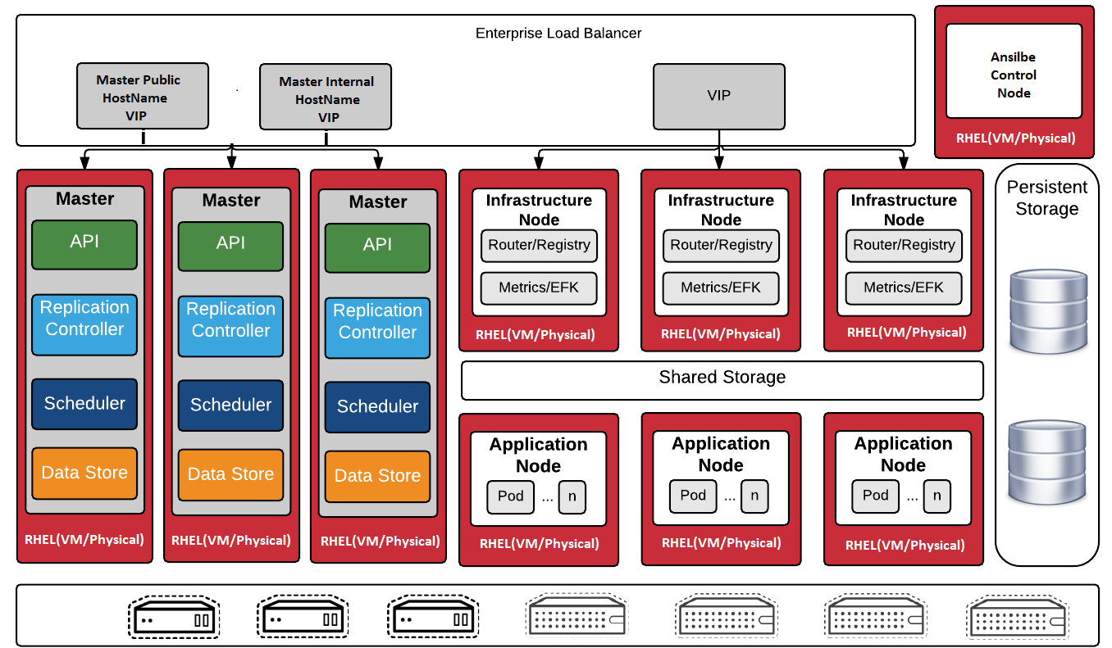
RBC OCP Architecture: 10m

Slide 10





RBC OCP Eco-System
SAI
GCC
Aqua
GitHub
Scan
Artifactory
Policy Enforcement
Source Code
Image
Image Pull
Metrics/Capacity
Cloud Forms
S2I build
Master
Master
10.5.100.10
10.5.100.20
10.5.100.30
10.6.100.10
10.6.100.20
10.6.100.30
Elastic Search

Slide 11
RBC Apps on OCP: 15 min
Jenkins Master Slave – Sahil: 6 min
Chorus – Thomas: 6 min
RBC Express - Dhwanil: 3 min

Slide 12
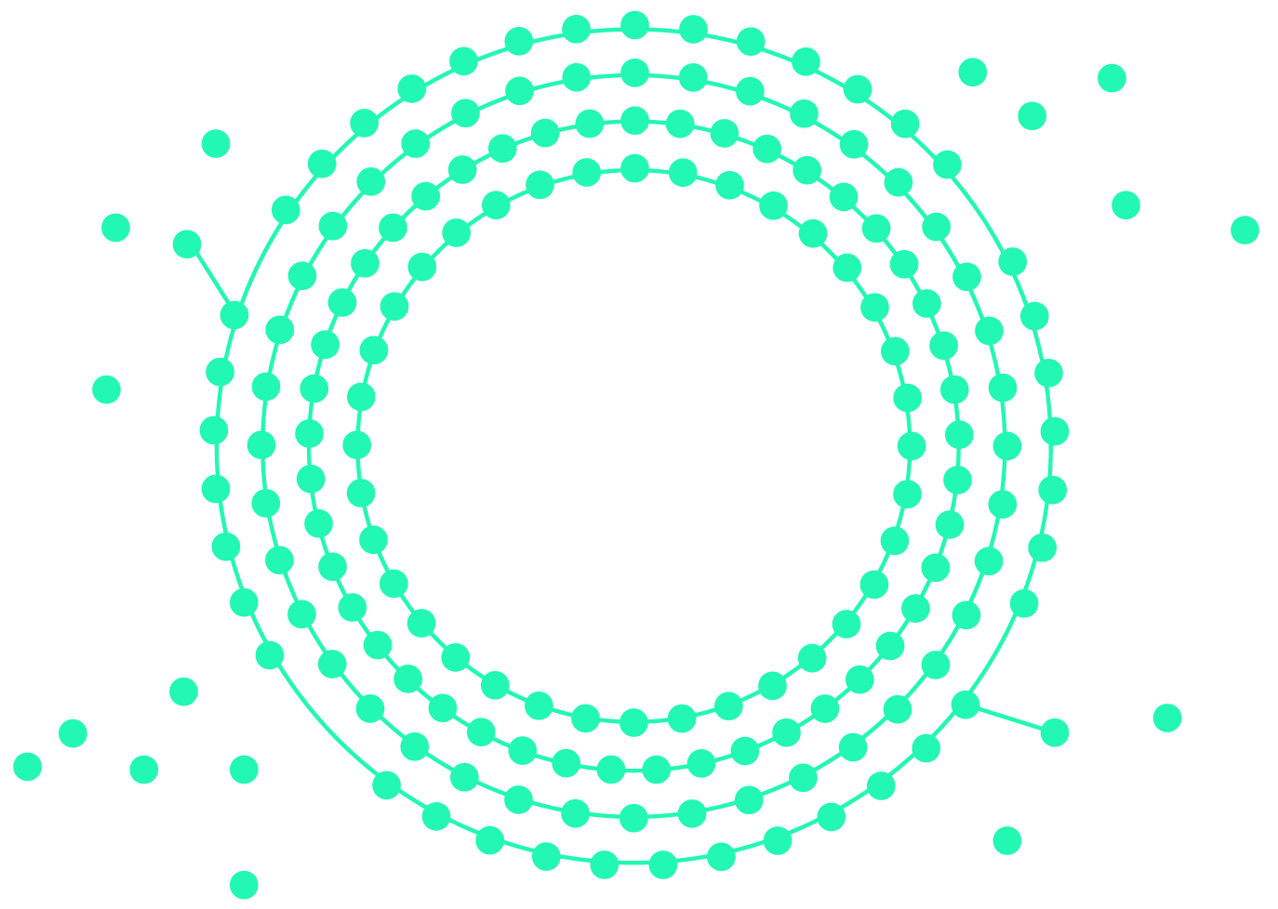


Jenkins Master/Slave - OpenShift
Deploying customized Jenkins Master & a Slave on a container

Slide 13
Jenkins Master/Slave - Benefit to App Devs
Flexibility to fully customize and own Jenkins master(s) with any new plug-ins
No need to wait for VM’s.
No longer constrained to a shared Master Jenkins instance
Jenkins Maven Slave(s) can be spun up and turned down "as needed" to provide the desired environment(s), no longer requiring dedicated VMs

Slide 14
Jenkins Master/Slave - Benefit to App Devs
Takes less than 2 minutes to spin up Jenkins versus traditional VM process which adds four (4) weeks.
Includes LDAP and AD group integration, for role based access (Lead & Team) out of the box.
Includes Jenkins Master pipeline plugins & Jenkins Maven Slave
Flexibility to customize with additional plugins at their own schedule (individual instance does not impact others).
Traditionally 5-6 days for RBC Jenkins team to test new plugins

Slide 15
Jenkins Master/Slave - Contact Us
+RBC-DEVOPS - Team Fusion - RBCDEVOPSTeamFusion@rbc.com
Want to see containers in action live? Go to Booth 9

Slide 16
About Chorus
Started as single developer project to multifaceted team across T&O
REST API’s for sane consumption of otherwise insane/complex/difficult RBC systems
Monolithic to Microservices
Single JVM app
on Tomcat
Multiple Spring Boot apps on Docker
Multi-replica Spring Boot on OpenShift
Notes:
Began as a monolithic Java application (known as Agora) deployed on Tomcat
Small number of services (DNS, LB, Active Directory)
Collection of RESTful API’s for infrastructure & automation
Tightly coupled
Deploying the application:
Painful & slow
Manual
Extremely error prone
Early 2017 – Project rewrite began, renamed to “Chorus”
Refactored each service into its own microservice, packaged as a Docker image
Built on Spring Framework & Netflix OSS
Deploying the new suite of applications via Docker Compose:
Deployments were more complex
Still very manual and error prone
A service had to be brought offline to roll out a new image
Difficult to operate Docker engine and full OS, tricky to troubleshoot

Slide 17
Chorus – Migration to OpenShift
Continuous integration & delivery
Cloud native scaling
oc scale --replicas=5 dc/myservice
Multi-tenant
Easily deployable & replicated
oc process -f app_template.yml \ –p MYPARAM=val | oc create –f
Notes:
End of 2017 – begin migrating workloads to OpenShift
Manual Docker image creation replaced by Source-to-Image (S2I) build process
Standard build tools (Maven, Gradle) on top of Red Hat JDK 8 builder images
Continuous integration & delivery
Create new container, wait for app health checks to pass and flip traffic onto the new and spin down the old version
Enables quick roll out of changes to a service with minimal interruption to client requests
Greatly simplified rollback
Services are deployed in parallel via Jenkins. Much faster time-to-deploy compared to serial Docker approach
Automated release tests. Ability to run a suite of integration, performance and smoke tests against newly deployed containers as part of pipeline
Native OpenShift plugins for managing deployments through Jenkins. Enable use of declarative pipeline
Developers can deploy their own “private” instance of Chorus (in its entirety) via OpenShift for experimentation, learning, in-depth integration testing, etc.

Slide 18
Chorus – Next Steps
Data center high availability (DNS, DB)
Move to native OpenShift / Kubernetes resources (Services, Routes replacing Netflix OSS)
A/B testing
Chorus Instances For Everyone
Notes:
Multi-datacenter high availability (DNS load balancing, database replication)
Rationalization of supporting services used in Chorus
Eureka (Service Discovery). Replace with native Kubernetes Services for internal cluster DNS resolution
Replace legacy Netflix Zuul API gateway with OpenShift routes
Other candidates such as Ribbon (client-side load balancing, replaced by Kubernetes Services) and Cloud Config (replace with ConfigMaps, Hashicorp Vault?)
A/B testing
Start experimenting with new features by running multiple versions of the same service in parallel. Use OpenShift routes to steer subset of traffic to A/B versions of a service
Multiple replicas of Chorus instances for individual user bases. Replication of a subset of the services to serve a particular use case or clients. Isolate services or datastores from general public use for a specialized purpose.

Slide 19


Lift-&-shift Legacy Apps - OpenShift
Deploying Monolithic Legacy RBC Express using S2I

Slide 20
About RBC Express & Benefits
Business critical Monolithic application running on WebSphere
External integrations with Enterprise MQ, DB2 and Teradata
Lift-n-shift using Websphere-Liberty-s2i
Legacy component and new/existing Microservices on same platform, makes deployment and integration seamless

Slide 21
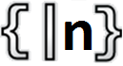





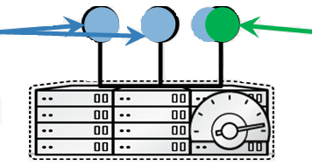
Lift-&-shift RBC-X Using S2i
Code Change
SCM of Choice
GitHub
GitLab
Bitbucket
Assembla
Nexus
Webhook API
WebSphere Liberty Docker Image
Source-To-Image Scripting
WebSphere Liberty Docker Image
Source-To-Image Scripting
WebSphere Liberty Docker Image
S2i Build
WebSphere Liberty Docker Image
Route
RBC-X Builder Image
RBC-X Builder Image
Rolling Deployments
B/G
Artifactory
Artifactory
Openshift Cluster

Slide 22
Q & A: 10 min

Slide 23
OpenShift Resources
RedHat OpenShift Doc:
https://access.redhat.com/documentation/en-us/openshift_container_platform/?version=3.6
RedHat OpenShift Developer Guide:
https://access.redhat.com/documentation/en-us/openshift_container_platform/3.6/html/developer_guide/
OpenShift WorkShop:
https://github.com/RedHatWorkshops/openshiftv3-workshop
RBC OpenShift Slack Channel:
#openshift (30 members at the moment)

Slide 24



2018
Visit the Expo Floor to learn from your peers and interact with RBC project teams.
For presentations and more info:
DevOps Expo
Save the Date!
September 26, 2018

